Slide 1
Strategic Marketing Simulator 1.0 Sprint 3 review
Strategic Marketing Simulator 1.0
Team # 15
Team Members
Jeffrey Carman
Javier Andrial
Product Owner: Joseph Cilli
Project Mentor: Masoud Sadjadi

Slide 2
Introduction – What is Strategic Market Simulator
Strategic Market Simulator
An Online Website/Simulator for marketing students to experience consequences of their decisions based on their Hotels parameters, current period parameters, and their peers decisions.
Game
Hotel
Student

Slide 3
Responsibilities
Responsibilities this Sprint
Manage Page
Create Admin User
Create Bot User with their Hotel
View All Games
Create Game
View All users in a Game
View All Users
Activate User accounts
De-Activate User Accounts

Slide 4
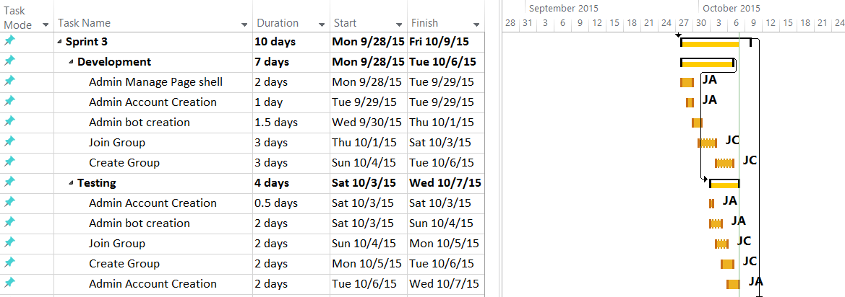
Sprint Schedule

Slide 5
Live Demonstration
Creating Admin User
Creating a Bot User
Creating a Game
View All Users
De-Activating/Activating Users

Slide 6
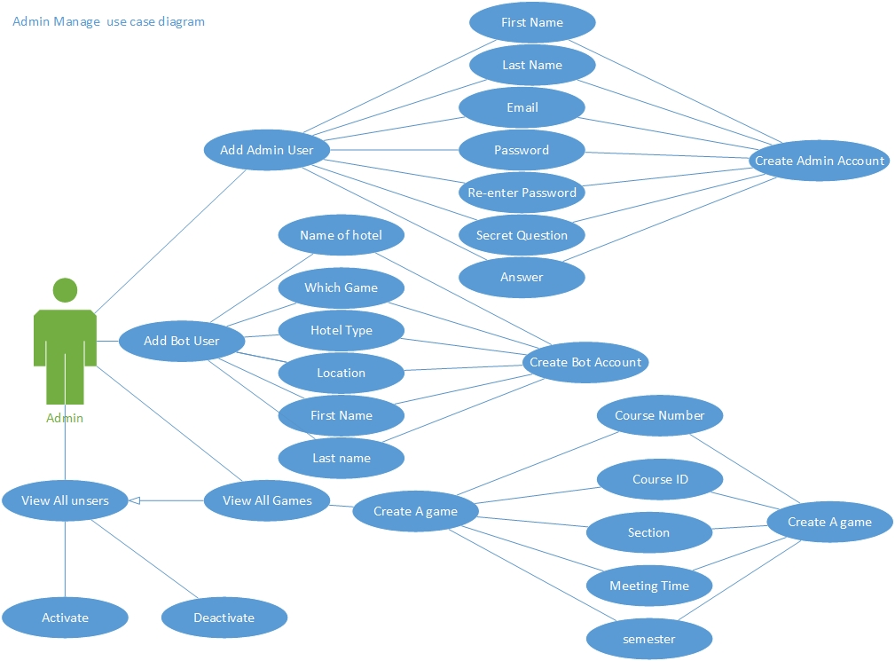
Use Cases Modeling

Slide 7
User Stories
User Story #718 - Manage page
Admin can click on this link to go to the Manage Page
Admin can Create Administrative accounts
Admin can Create Bot Users and their Group/Hotel
Admin can create a Game
Admin can View all Users
Admin can Activate/De-activate
Manage Page will only be accessible to administrative accounts
This Page will display all Users, all Games, as well as create Administrative accounts and Bot Accounts
Tasks
Add methods to Database class to create and return arrays of entries.
Write methods to navigate through Manage Page
Write methods to display subpages
Validate user input
Appropriate error message upon value.

Slide 8
User Stories
User Story #689 – Create Game
While on the Manage Page Admin clicks View All Games
Admin is shown a list of all Games on the Database
Admin clicks Create Game
Admin fills out appropriate information
Tasks
Add methods to Database class to create a Game
Add a method to Database class to return arrays of all games
Write methods to navigate through View all Games
Validate user input
Appropriate error message upon value.

Slide 9
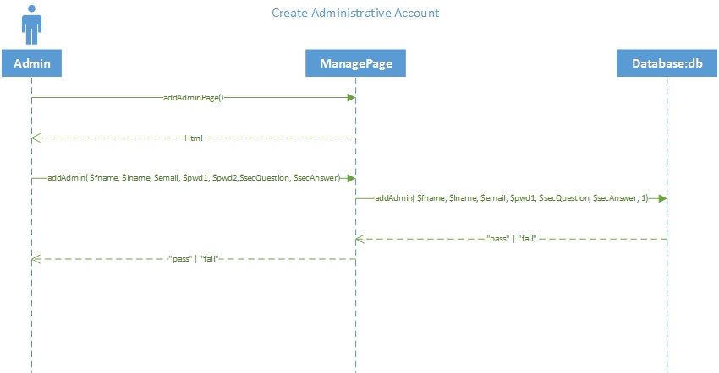
Sequence Diagrams

Slide 10
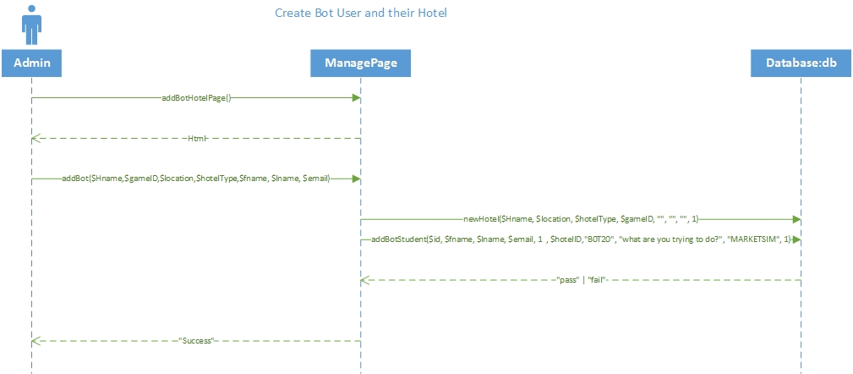
Sequence Diagrams

Slide 11
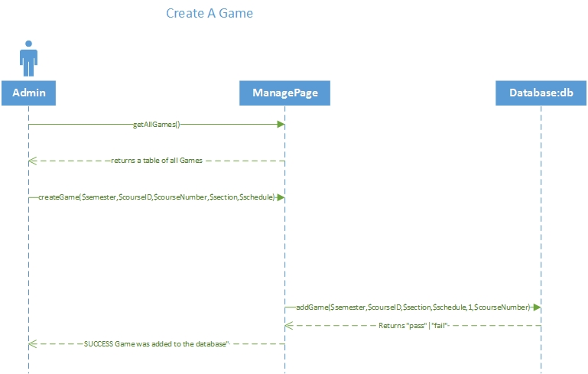
Sequence Diagrams

Slide 12
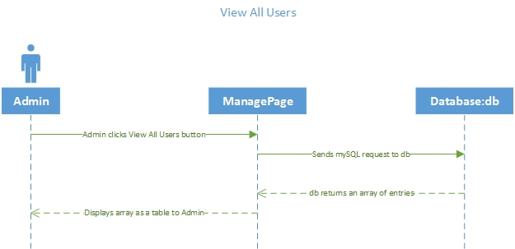
Sequence Diagrams

Slide 13
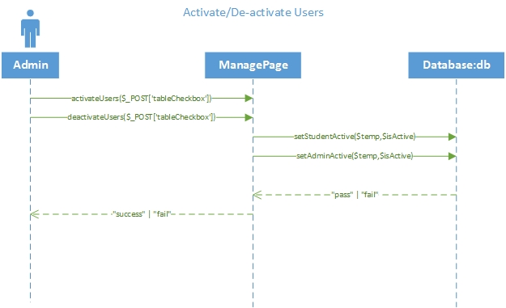
Sequence Diagrams

Slide 14
Software Testing
PHPUnit 4.8.9 by Sebastian Bergmann and contributors.Runtime: PHP 5.5.9-1ubuntu4.11Configuration: /srv/marketsim/www/Tests/phpunit.xml
AdminController
ok - AdminControllerTest::test__constructInvalidPar
ok - AdminControllerTest::test__construcValidPar
ok - AdminControllerTest::test_CreatePage
ok - AdminControllerTest::test_addAdminPage
ok - AdminControllerTest::test_addBotPage
ok - AdminControllerTest::test_addBotHotelPage
ok - AdminControllerTest::test_createGamePage
Database
ok - databaseTest::test_updateStudentHotelValid
ok - databaseTest::test_updateStudentHotelInValid
ok - databaseTest::test_getGameValid
ok - databaseTest::test_getGameinValid
ok - databaseTest::test_getGroupValid
ok - databaseTest::test_getGroupinValid
ok - databaseTest::test_getGameByCourseValid
ok - databaseTest::test_getGameByCourseinValid
ok - databaseTest::test_getLocationValid
ok - databaseTest::test_getLocationinValid
ok - databaseTest::test_getAllGames
ok - databaseTest::test_getAdvertisingValid
ok - databaseTest::test_newHotelValid
ok - databaseTest::test_SearchHotelsValid
ok - databaseTest::test_SearchHotelsInValid
ok - databaseTest::test_getGroupsForGameValid
ok - databaseTest::test_getGroupsForGameinValid

Slide 15
Test Case
Test ID: | AdminControllercreateGamePageTest42
Description: | Test database functioncreateGamePage with valid input
Test Steps | Step 1: Create AdminController object $a
 | Step 2:"<div class='' align='left'>". "<h2>Game Creation Page</h2>". "<h3>Course Number</h3>". "<input type = 'text' name = 'textbox_courseNumber' pattern='[0-9]{5}' placeholder = '88529' title='5 digit number'>". "<h3>Course ID</h3>". "<input type = 'text' name = 'textbox_courseID' placeholder = 'MAR2015'>". "<h3>Section</h3>". "<input type = 'text' name = 'textbox_section' placeholder='U02'>". "<h3>Semester of Game</h3>". "<input type = 'text' name = 'textbox_semester' placeholder='FALL 2016'>". "<h3>Course Meeting time</h3>". "<input type = 'text' name = 'textbox_schedule' placeholder='mwf 12pm-1:30pm'>". "<br />". "<br />"."<br />". "<input name='button_addGame' type = 'submit' value = 'Create Game' class='btnbtn-primary'/>". "</div>"
 | Step 3: assertEquals($a->createGamePage(), $result)
Tester: | Javier Andrial
Result: | Pass

Slide 16

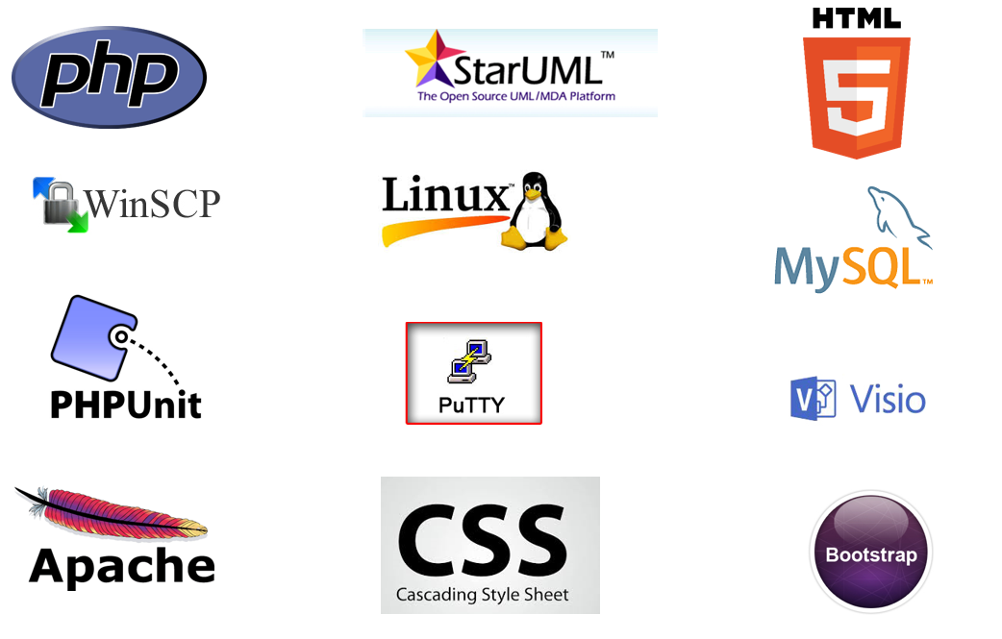



Introduction

Slide 17
Sprint Schedule

Slide 18
Sprint 3 Stories – A summary
User story 769: Join Group
User story776: Create Group
Modification to original design

Slide 19
User stories
User Story # 776 - Student Create Group
The student decides to create a new group and clicks on the “create a new group” from the join group page.
The student clicks on the games drop down list and selects a game.
The student enters a group name in the group name text box
The student clicks on the create new group button.
The user is redirected to his or her homepage.
Tasks
Create Group Page (Javascript, Jquery, Ajax, CSS, Bootstrap)
Update Database class
Create new group page (Javascript, Jquery, Ajax, CSS, Bootstrap)
Insert new Group helper page

Slide 20
User stories – use case modeling
User Story # 769 - Student Join Group
A new user is directed to Join group page. Student has the option to join a already created group or create a new group.
If a user joins a group they first select the game from the game drop down list.
They next select a group from the dynamically populated group drop down list.
The user clicks join group.
The user is directed to their homepage.
Tasks
Update Database class (Javascript, Jquery, Ajax, CSS, Bootstrap)
Create Join group page
Insert new Group helper page (Javascript, Jquery, Ajax, CSS, Bootstrap)

Slide 21
User stories
User Story # 669- User login
Tasks
Add methods to PHP Database class for user login.
write scripts to communicate with to Database subsystem from front end.
write scripts to navigate user to homepage upon success.
Appropriate error message upon value.
(Future release should have account lockout policy)

Slide 22
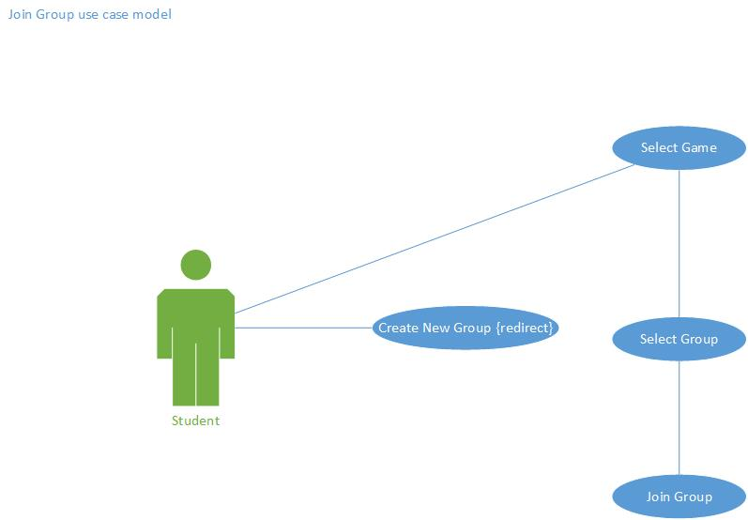
UML Modeling – Join Group Use Case

Slide 23
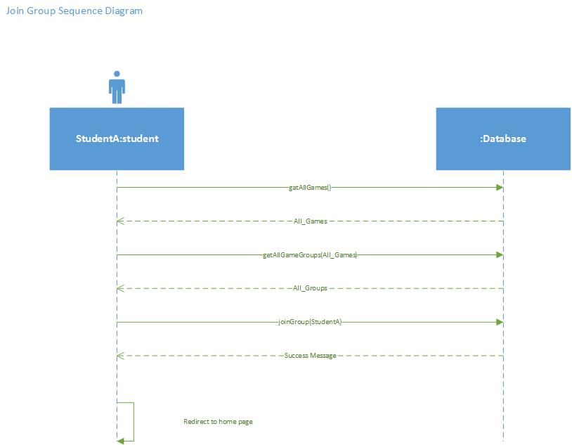
UML Modeling – Join Group Sequence Diagram

Slide 24
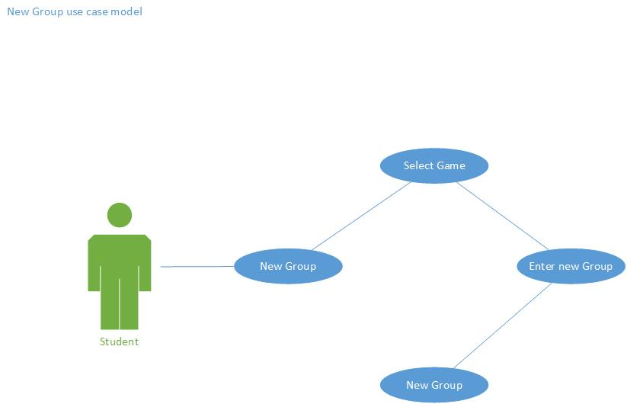
UML Modeling – Create Group Use Case

Slide 25

UML Modeling – Create Group Sequence Diagram

Slide 26
Software Testing
Example Test Case (Subsystem):
Test ID: | databasegenPassTest8
Description: | Test database function genPass with valid input
Test Steps | Step 1: create input string $pwd = "somePass1234"
 | Step 2: create input String $email = "some@email.com";
 | Step 3: create database object $db
 | Step 4: create database object $db2
 | Step 5: assertEquals($db->genPass($pwd, $email),$db2->genPass($pwd, $email))
Tester: | Jeffrey Carman
Result: | Pass

Slide 27
Software Testing Output
PHPUnit 4.8.9 by Sebastian Bergmann and contributors.Runtime: PHP 5.5.9-1ubuntu4.11Configuration: /srv/marketsim/www/Tests/phpunit.xml
AdminController
ok - AdminControllerTest::test__constructInvalidPar
ok - AdminControllerTest::test__construcValidPar
ok - AdminControllerTest::test_CreatePage
ok - AdminControllerTest::test_addAdminPage
ok - AdminControllerTest::test_addBotPage
ok - AdminControllerTest::test_addBotHotelPage
ok - AdminControllerTest::test_createGamePage
Student Controller
ok - StudentControllerTest::test__StudentControllerConstructInvalidPar
ok - StudentControllerTest::test__StudentControllerConstrucValidPar
ok - StudentControllerTest::test__StudentControllerCreateForgotPage
ok - StudentControllerTest::test__StudentControllerfindStudentAccountEmptyParameter
ok - StudentControllerTest::test__StudentControllerfindStudentAccount
ok - StudentControllerTest::test__StudentControllerresetPasswordEmptyEmail
ok - StudentControllerTest::test__StudentControllerresetPasswordInvalidEamil

Slide 28
Software Testing Output
PHPUnit 4.8.9 by Sebastian Bergmann and contributors.Runtime: PHP 5.5.9-1ubuntu4.11Configuration: /srv/marketsim/www/Tests/phpunit.xml
Database
ok - databaseTest::test_updateStudentHotelValid
ok - databaseTest::test_updateStudentHotelInValid
ok - databaseTest::test_getGameValid
ok - databaseTest::test_getGameinValid
ok - databaseTest::test_getGroupValid
ok - databaseTest::test_getGroupinValid
ok - databaseTest::test_getGameByCourseValid
ok - databaseTest::test_getGameByCourseinValid
ok - databaseTest::test_getLocationValid
ok - databaseTest::test_getLocationinValid
ok - databaseTest::test_getAllGames
ok - databaseTest::test_getAdvertisingValid
ok - databaseTest::test_newHotelValid
ok - databaseTest::test_SearchHotelsValid
ok - databaseTest::test_SearchHotelsInValid
ok - databaseTest::test_getGroupsForGameValid
ok - databaseTest::test_getGroupsForGameinValid
Database
ok - databaseTest::test__constructInvalidPar
ok - databaseTest::test__construcValidPar
ok - databaseTest::test_searchForStudentsFound
ok - databaseTest::test_searchForStudentsNotFound
ok - databaseTest::test_getStudentFound
ok - databaseTest::test_getStudentNotFound
ok - databaseTest::test_addStudent
ok - databaseTest::test_genPass
ok - databaseTest::test_updateStudentPassword
ok - databaseTest::test_updateStudentPasswordInValid
ok - databaseTest::test_addGameValid
ok - databaseTest::test_addGameinValid
ok - databaseTest::test_updateAdminPasswordValid
ok - databaseTest::test_updateAdminPasswordinValid
ok - databaseTest::test_setStudentActiveValid
ok - databaseTest::test_setStudentActiveinValid
ok - databaseTest::test_AdminActiveValid
ok - databaseTest::test_AdminActiveinValid

Slide 29
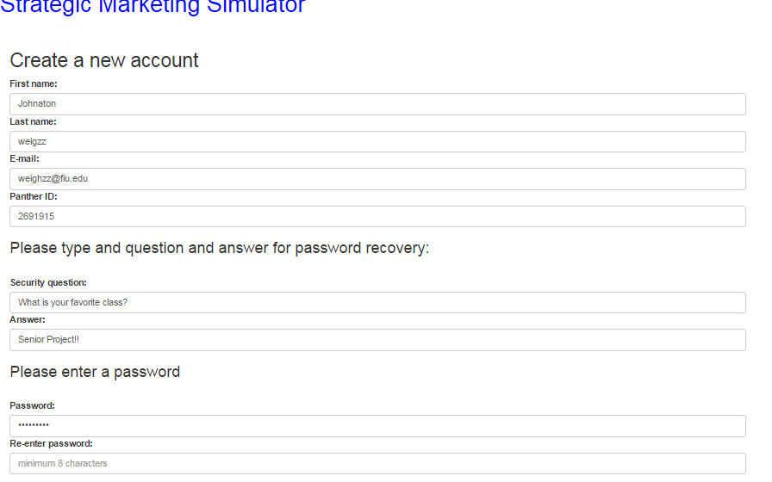
Demo

Slide 30

Demo

Slide 31
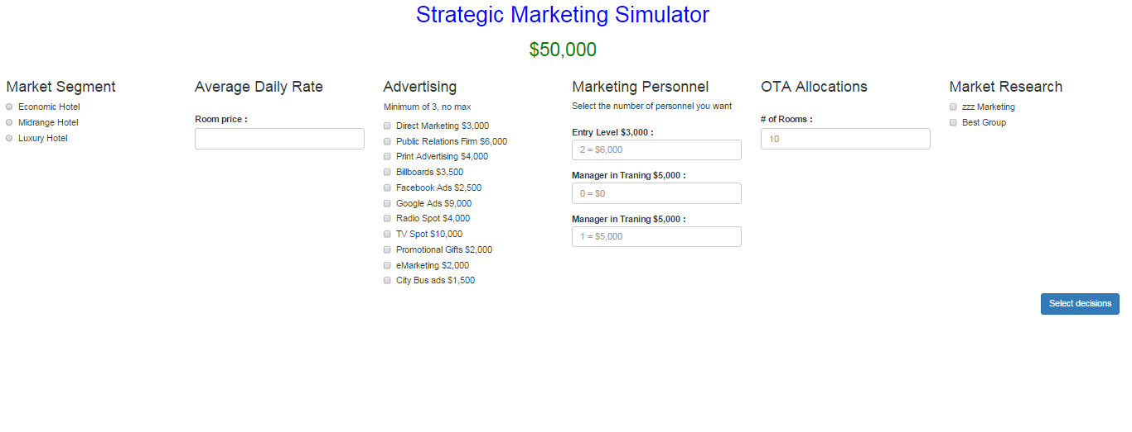
Ahead of schedule

Slide 32
Strategic Marketing Simulator 1.0
Questions?

